Slide 1
Professional Practice
Update / Ethics

Slide 2
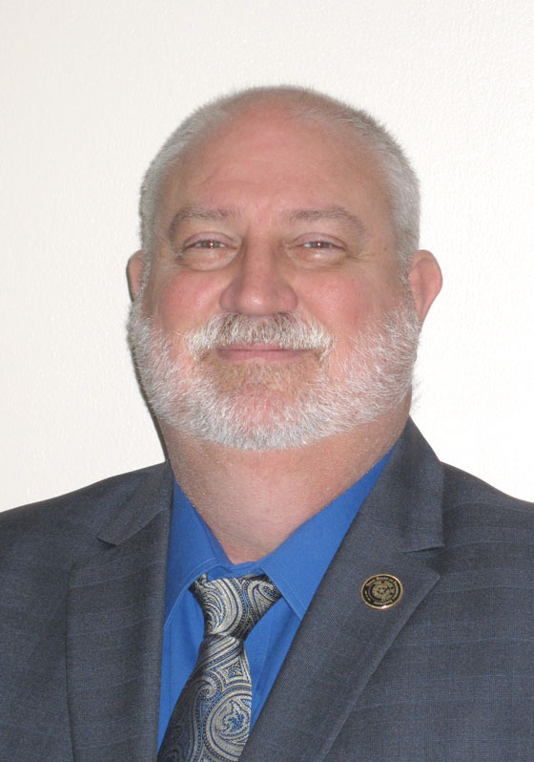
Presenter
Rick Strong, P.E.
Director of Licensing & Registration
Rick.Strong@pels.texas.gov

Slide 3
Webinar Info
Webinar audio can be heard through your computer speakers or phone.
All attendees will be in Listen-only mode.
During the presentation, use the Question feature in the webinar software, not the chat feature or the hand raising feature.
If there are questions, not addressed, please email the presenter.

Slide 4
Webinar Info
Ethics PDH Documentation
Documentation of attendance for Continuing Education.
Sponsor may provide a certificate or documentation.
TBPELS does not issue a certificate.
Copy of sign-up sheet.

Slide 5
Agenda
Covid-19 Update
About the Board
Core Functions
Professional Responsibility
Board Activities

Slide 6
COVID-19 Update
Agency Offices CLOSED to public
Will remain closed through at least July 2021
TBPELS Team is all teleworking
Email communication best (info@pels.texas.gov )
Telephone communication is limited
Operations NORMAL
Processing applications
Processing enforcement cases
Renewals ongoing

Slide 7
COVID-19 Update
FE / FS / PE Exam – Pearson VUE closed in April 2020
PE exam – NCEES cancelled the April 2020 Exam
RPLS exam – TBPELS cancelled April 2020 Exam
RPLS Exams given in OCTOBER 2020
NCEES PE Exams given in OCTOBER 2020
All Exams on Schedule for April 2021
FE / FS / PE – Pearson VUE is reopening – location by location
Cont. Ed. NOT canceled / modified at this time
Emergency Rule – PE Applicants +1 Year

Slide 8
Website and Social Media
http://pels.texas.gov
Facebook: Texas Board of Professional Engineers and Land Surveyors
Twitter: TBPELS_Exec
LinkedIn: Texas Board of Professional Engineers and Land Surveyors
YouTube: https://www.youtube.com/ channel/UCm0YTnjR3StveBxWhCT4MiA
Notes:
Our commitment is to communicate more frequently with more user-friendly information
TBPE makes announcements and posts general information and reminders through its social media links.

Slide 9
Texas Board of Professional Engineers and Land Surveyors
Nine Members - Appointed by Governor
5 Licensed Professional Engineers
1 Registered Professional Land Surveyor
3 Public Members
1 Ex-Officio Representative from GLO
Standard term is 6 years

Slide 10
TBPELS Board
Dr. Sina Nejad, PE, PEng Beaumont – Chairman
Lamberto “Bobby” Balli, PE San Antonio – Vice Chair
Rolando Rubiano, PE Harlingen – Secretary
Albert Cheng (public member) Houston – Treasurer
Ademola Adejokun, PE Arlington
Catherine Norwood, PE Midland
Kiran Shah (public member) Richmond
Coleen Johnson, RPLS Leander
Dr. Marguerite “Margo” McClinton Stoglin (public member) Grand Prairie
Mark Neugebauer, RPLS, LSLS Austin

Slide 11
TBPELS Staff
36 Staff members, Austin
Lance Kinney, PhD, PE - Executive Director
Michael Sims, PE - Compliance & Enforcement
Rick Strong, PE - Licensing & Registration
Janet Sobieski - Operations

Slide 12
TBPELS Mission
Public Safety & Welfare
Our mission is to protect the health, safety and welfare of the people of Texas through the licensure and registration of qualified individuals as professional engineers and land surveyors, compliance with applicable laws and rules, and education about engineering and land surveying.

Slide 13
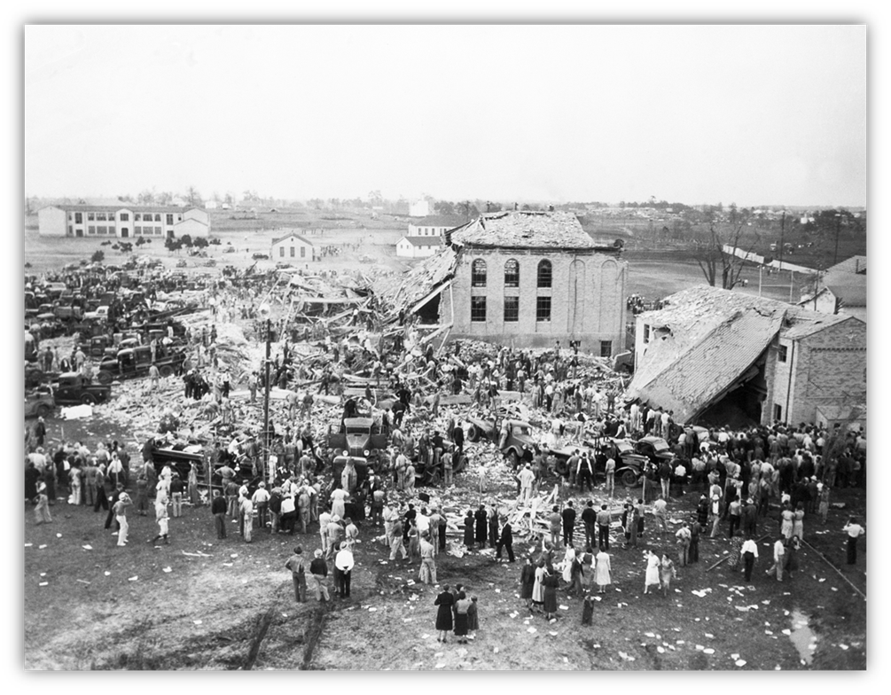
History – New London
Engineering License Created by Texas Legislature (45R) in 1937
New London School Explosion
300 students and teachers killed
Result of improperly designed mechanical and electrical devices
Established a Board to regulate the practice of engineering through licensing and rules of practice
Notes:
Two of the engineers are college professors and the others are in private practice. Of the 3 public members, 2 are lawyers and one is a CPA.
Rules-staff produced, board approves for public comment in the Texas Register, staff takes comments and proposes new rules for Board approval

Slide 14
TBPELS History
Over 140,000 Texas PE licenses granted since 1937.
Currently over 69,000 PE licensees.
Land Surveying Board was established in 1919.
Public Surveying Board was established in 1955.
Both surveying boards merged in 1979.
Merged with Engineering Board in 2019 - TBPELS.
Over 6,800 Texas RPLS registrations granted since 1955.
Currently over 2,800 Registered Surveyors.

Slide 15
Professional Licensing & Registration
System to Protect the Public:
Sets the minimum standards for licensure as a Professional Engineer and registration as a Professional Land Surveyor
Sets continuing practice and competence standards
Sets ethical and professional standards
Compliance with these standards of professional practice
Standards for indicating competence (titles, seals, etc.)
Prevents unqualified individuals from offering or practicing where it could endanger the public
Notes:
Professionals include doctors, lawyers, engineers, etc. There is an understanding that professionals are regulated to ensure ethical behavior which creates a safer environment

Slide 16
Professional Licensing
Fields that are regulated and licensed vary among individual states. Among regulated fields are health care professionals (medical doctors, nurses); psychologists; lawyers; teachers; engineers; …- Wikipedia
Most of these fields impact the public one person at a time.
The work done by engineers generally has the potential to affect many.
Notes:
Professionals include doctors, lawyers, engineers, etc. There is an understanding that professionals are regulated to ensure ethical behavior which creates a safer environment

Slide 17
Public Perception - Licensure
Survey by McKinley Advisors
Notes:
Professionals include doctors, lawyers, engineers, etc. There is an understanding that professionals are regulated to ensure ethical behavior which creates a safer environment

Slide 18
Public Perception - Ethics
Please tell me how you would rate the honesty and ethical standards of people in these different fields -- very high, high, average, low or very low? (Gallup 2019)
Profession | % Very High / High
Nurses | 85%
Engineers | 66%
Medical Doctors | 65%
Pharmacists | 64%
Dentists | 61%
“The only nonmedical profession that Americans now hold in a similar level of esteem is engineers, with 66% saying individuals in this field have high levels of honesty and ethics.”
https://news.gallup.com/poll/274673/nurses-continue-rate-highest-honesty-ethics.aspx
Notes:
Professionals include doctors, lawyers, engineers, etc. There is an understanding that professionals are regulated to ensure ethical behavior which creates a safer environment

Slide 19
Protection of Public Health, Safety, Welfare
Professional Practice and Responsibility
Professional Licensure
Ethics
Education
Experience
Exams

Slide 20
Professional Responsibility: Competence
Competence is gained by Education and Experience; Measured by FE and PE examinations
Texas uses nationally accepted standards, but considers each application independently.
Texas does not license by discipline, but Professional Engineers must not practice outside of their competence.
§137.59(a) Engineers shall practice only in their areas of competence.
Notes:
Professionals include doctors, lawyers, engineers, etc. There is an understanding that professionals are regulated to ensure ethical behavior which creates a safer environment

Slide 21
Professional Responsibility: Ethics
Protection of Public Health, Safety, Welfare
Ethical responsibilities and expectations
Avoid Conflicts of Interest
Be a Faithful Agent
Be prepared to have a dissenting opinion, if necessary
Obligation to be aware of violations of the Act.
How does this protect the public?
We are expected to know the right thing to do and to do the right thing in the practice of engineering.
Notes:
Professionals include doctors, lawyers, engineers, etc. There is an understanding that professionals are regulated to ensure ethical behavior which creates a safer environment

Slide 22
Professionalism
Protection of Public Health, Safety, Welfare
Communication
Honesty
Clarity (not misleading)
Respectful of all parties
Maintain Public Trust
Timely communication with the TBPELS
How does this protect the public?
We are expected to be complete and correct in the practice of engineering.
Notes:
Professionals include doctors, lawyers, engineers, etc. There is an understanding that professionals are regulated to ensure ethical behavior which creates a safer environment

Slide 23
Professional Responsibility
As a licensed or registered professional, you have:
A wide range of actions
A wide range of options
Legal Obligations
Ethical Obligations
To protect the health, safety, and welfare of the public
Professional Responsibility
Notes:
1/29/2021
23
Know the CE requirements because this is usually have a few questions. Up to five hours of self-study
14 hours can be carried forward, one hour must be in ethics every year,
An hour should be considered the amount of time on topic; topics are not pre-approved so it’s the honor system that what you have taken is relevant to your professional practice per statute 1001.210. 137.17
There is not an exemption for over 65 – which is the #1 reason we return renewal checks
If you renew and haven’t done the CE it is fraudulent. Otherwise good engineers can be busted.
There is no pre-certification; PEs are expected to know what classes are accepted.
All done electronically.
Ask them their experience – how many of you have been audited? Was it pretty easy? Just needed to have documentation, right?

Slide 24
Professional Responsibility
Board Rules, Chapter 137, Subchapter C
Signing and Sealing
Direct Supervision / Responsible Charge
Objective and Truthful
Care and Diligence
Actions of Others
Aiding and Abetting
Codes and Ordinances
Continuing Education
Professional Services Procurement Act (PSPA)
Notes:
1/29/2021
24
Know the CE requirements because this is usually have a few questions. Up to five hours of self-study
14 hours can be carried forward, one hour must be in ethics every year,
An hour should be considered the amount of time on topic; topics are not pre-approved so it’s the honor system that what you have taken is relevant to your professional practice per statute 1001.210. 137.17
There is not an exemption for over 65 – which is the #1 reason we return renewal checks
If you renew and haven’t done the CE it is fraudulent. Otherwise good engineers can be busted.
There is no pre-certification; PEs are expected to know what classes are accepted.
All done electronically.
Ask them their experience – how many of you have been audited? Was it pretty easy? Just needed to have documentation, right?

Slide 25
Signing and Sealing
Signing and Sealing indicates:
The work was done by the professional OR
Under the direct supervision of the professional
The work is complete and accurate
Preliminary work if properly notated (permit, bidding, etc.)
Responsible parties if more than one professional
Date issued
Revisions
Signing and Sealing indicates your professional responsibility for the work.
Notes:
1/29/2021
25
Know the CE requirements because this is usually have a few questions. Up to five hours of self-study
14 hours can be carried forward, one hour must be in ethics every year,
An hour should be considered the amount of time on topic; topics are not pre-approved so it’s the honor system that what you have taken is relevant to your professional practice per statute 1001.210. 137.17
There is not an exemption for over 65 – which is the #1 reason we return renewal checks
If you renew and haven’t done the CE it is fraudulent. Otherwise good engineers can be busted.
There is no pre-certification; PEs are expected to know what classes are accepted.
All done electronically.
Ask them their experience – how many of you have been audited? Was it pretty easy? Just needed to have documentation, right?

Slide 26
Professional Services Procurement Act (PSPA)
The PSPA (Texas Government Code Chapter 2254) prohibits governmental entities from selecting providers of certain professional services on the basis of competitive bidding.
Includes cities, counties, school districts, state agencies and other public bodies.
When selecting an architect, engineer, or land surveyor, the PSPA requires a governmental entity follow Qualifications Based Selection (QBS)
QBS is a two-step process which requires the governmental entity to:
First - select the most highly qualified provider of services, and
Second - negotiate a price
Notes:
1/29/2021
26
Know the CE requirements because this is usually have a few questions. Up to five hours of self-study
14 hours can be carried forward, one hour must be in ethics every year,
An hour should be considered the amount of time on topic; topics are not pre-approved so it’s the honor system that what you have taken is relevant to your professional practice per statute 1001.210. 137.17
There is not an exemption for over 65 – which is the #1 reason we return renewal checks
If you renew and haven’t done the CE it is fraudulent. Otherwise good engineers can be busted.
There is no pre-certification; PEs are expected to know what classes are accepted.
All done electronically.
Ask them their experience – how many of you have been audited? Was it pretty easy? Just needed to have documentation, right?

Slide 27
Continuing Education
15 hours for PE / 12 hours for RPLS
Must include 1 hour of Ethics for PE / 3 hours for RPLS
May include self-study (5 hours max – PE / 4 hours max – RPLS)
May include up to 3 hours of Educational Outreach
Random audits ongoing
Keep documentation for 3 years
Notes:
1/29/2021
27
Know the CE requirements because this is usually have a few questions. Up to five hours of self-study
14 hours can be carried forward, one hour must be in ethics every year,
An hour should be considered the amount of time on topic; topics are not pre-approved so it’s the honor system that what you have taken is relevant to your professional practice per statute 1001.210. 137.17
There is not an exemption for over 65 – which is the #1 reason we return renewal checks
If you renew and haven’t done the CE it is fraudulent. Otherwise good engineers can be busted.
There is no pre-certification; PEs are expected to know what classes are accepted.
All done electronically.
Ask them their experience – how many of you have been audited? Was it pretty easy? Just needed to have documentation, right?

Slide 28
Continuing Education
Exemptions - must be claimed when you renew
1st renewal if PE exam was within a year of licensure
Active duty military deployment
Disability
Inactive status
Being over 65 is not an exemption for Continuing Ed
Notes:
1/29/2021
28
Know the CE requirements because this is usually have a few questions. Up to five hours of self-study
14 hours can be carried forward, one hour must be in ethics every year,
An hour should be considered the amount of time on topic; topics are not pre-approved so it’s the honor system that what you have taken is relevant to your professional practice per statute 1001.210. 137.17
There is not an exemption for over 65 – which is the #1 reason we return renewal checks
If you renew and haven’t done the CE it is fraudulent. Otherwise good engineers can be busted.
There is no pre-certification; PEs are expected to know what classes are accepted.
All done electronically.
Ask them their experience – how many of you have been audited? Was it pretty easy? Just needed to have documentation, right?

Slide 29
Continuing Education
Texas Board rules do not require courses from an Approved Provider list for engineers.
TBPELS staff does not pre-approve courses.
A Texas PE decides if a course is related to his or her practice and has “educational, technical, ethical, or managerial content”
Keep in mind the goal of the Continuing Education program
Think about Continuing Education throughout the year
Notes:
1/29/2021
29
Know the CE requirements because this is usually have a few questions. Up to five hours of self-study
14 hours can be carried forward, one hour must be in ethics every year,
An hour should be considered the amount of time on topic; topics are not pre-approved so it’s the honor system that what you have taken is relevant to your professional practice per statute 1001.210. 137.17
There is not an exemption for over 65 – which is the #1 reason we return renewal checks
If you renew and haven’t done the CE it is fraudulent. Otherwise good engineers can be busted.
There is no pre-certification; PEs are expected to know what classes are accepted.
All done electronically.
Ask them their experience – how many of you have been audited? Was it pretty easy? Just needed to have documentation, right?

Slide 30
Continuing Education
NCEES system for Continuing Professional Competence (CPC) tracking and reporting
No fee to register and create an account
Upload documentation
Report as needed for different Boards
http://ncees.org/cpc/
Notes:
1/29/2021
30
Know the CE requirements because this is usually have a few questions. Up to five hours of self-study
14 hours can be carried forward, one hour must be in ethics every year,
An hour should be considered the amount of time on topic; topics are not pre-approved so it’s the honor system that what you have taken is relevant to your professional practice per statute 1001.210. 137.17
There is not an exemption for over 65 – which is the #1 reason we return renewal checks
If you renew and haven’t done the CE it is fraudulent. Otherwise good engineers can be busted.
There is no pre-certification; PEs are expected to know what classes are accepted.
All done electronically.
Ask them their experience – how many of you have been audited? Was it pretty easy? Just needed to have documentation, right?

Slide 31
Compliance & Enforcement
Technical / Ethical / Professional
Approximately 600 Cases opened last year
~69,000 licensed PEs
~2,800 registered RPLS
About 65% resolved with Voluntary Compliance
Board action includes range of action up to revocation
Less than 10% Dismissed

Slide 32
Enforcement - Filing A Complaint
Mail, email, phone, facsimile – all are acceptable for initial contact
Anonymous complaints are accepted
A complaint form or detailed letter/email is needed to cover all the bases
Forms can be found Online
Provide specific instances of violation
Provide evidence to show probable cause
Notes:
Ou
32

Slide 33
Board Actions
Reprimands (Formal and Informal)
Suspension (possible probation)
Refuse to Renew
Revocation
$5,000 per violation per day (Eng) / $1,500 (LS)
Cease and Desist Orders
Emergency Suspension
Notes:
Be aware of consequences.
Make sure you know the rules and statutes and please call us if you have any questions at all. We want to prevent the cases by providing you answers before the violations occur!
33

Slide 34
Additional Enforcement Options
Ethics Courses
National Institute for Engineering Ethics (Texas Tech)
Technical Courses
Restitution
Practice limitations
Civil or Criminal cases
Assisting Jurisdictional Authorities
Notes:
Be aware of consequences.
Make sure you know the rules and statutes and please call us if you have any questions at all. We want to prevent the cases by providing you answers before the violations occur!
34

Slide 35
Enforcement
By law, all violations, except informal reprimands, must be published
On TBPELS website by Board Meeting Date
Added to NCEES Enforcement Exchange (national database)
Published in the newsletter which is mailed at least annually and quarterly E-newsletter emails
Notes:
35

Slide 36
Preventing Complaints
CLEAR:
Communication (between all parties)
Contract (expectations and responsibilities)
Calculations and designs (be prepared to support)
Keep your Documentation
Most importantly – know the law and contact us if you have a question!
Notes:
1/29/2021
36
We don’t want to hear about you – and here’s how!
Communication – usually a simple misunderstanding can be cleared up easily – manage expectations in advance
Contracts – get it in writing so everyone understands
Calculations – show your work and keep the notes. It will help if there is ever a question about what was done.

Slide 37
Engineering Policy Advisory Opinions
Provision Added to TEPA in 2003
Allows Board to develop formal written interpretations of law and rules for specific or hypothetical ‘Gray Areas’
~50 interpretations for a variety of subjects
http://pels.texas.gov/policy.htm
How to submit PAO Request / Forms at:
http://pels.texas.gov/Policy_Advisory.htm

Slide 38
TBPELS – Technical Experts
We Need Your Help – Both Engineering and Surveying
TBPELS keeps a list of qualified Technical Experts to be used to review Enforcement cases.
Volunteer/Pro bono or Service Contract as appropriate
Possible Continuing Education credit
Find out More:
Board Rule 139.23
http://pels.texas.gov/technical_experts.htm
Notes:
Two of the engineers are college professors and the others are in private practice. Of the 3 public members, 2 are lawyers and one is a CPA.
Rules-staff produced, board approves for public comment in the Texas Register, staff takes comments and proposes new rules for Board approval

Slide 39
Surveyor Update
Merger Complete
Criminal History Record Check Ongoing for December 2020 Renewals
Rule Conversion Almost Complete
Rule Adoptions will be published in Texas Register by end of 2020
A few rules still ongoing with early 2021 due date
Notes:
The Sunset Advisory Commission reviews agencies every twelve years or so do determine whether it still serves a public need, which would cause the sun to “set” on the agency if not. This is the time when enabling statutes or laws are reviewed and can have changes made. Hearings will be held during the 2013 legislative session. There is an opportunity for public input at that time.

Slide 40
87th Legislative Session (2021)
Important Dates
November 9, 2020 – Bill Filing Begins
January 12, 2021 – Legislative Session Begins
March 12, 2021 – Bill Filing Deadline
May 31, 2021 – Adjourn Sine Die
TBPELS Tracks Bills
Bills related to Engineering and/or Surveying listed on TBPELS website
Notes:
The Sunset Advisory Commission reviews agencies every twelve years or so do determine whether it still serves a public need, which would cause the sun to “set” on the agency if not. This is the time when enabling statutes or laws are reviewed and can have changes made. Hearings will be held during the 2013 legislative session. There is an opportunity for public input at that time.

Slide 41
Engagement - Webinars
PE Ethics
March, June, September, December, + Monthly
Sign up online
LS Ethics in the works
FE Exam / Why become a PE? (Students)
FS Exam / Why become an RPLS? (Students)
How to Apply (EITs and SITs)
Notes:
Professionals include doctors, lawyers, engineers, etc. There is an understanding that professionals are regulated to ensure ethical behavior which creates a safer environment

Slide 42
Outreach
Fiscal Year | Attendees | Presentations
2014 | 14,866 | 155
2015 | 19,751 | 150
2016 | 19,554 | 138
2017 | 23,054 | 144
2018 | 23,104 | 168
2019 | 26,216 | 154
2020 | 25,216 | 91
Monthly and Quarterly Webinars
Face to Face Outreach
Includes K-12 / E-Week

Slide 43
Webinar Info
Documentation of attendance for Continuing Education purposes will be the follow up email from the Webinar system.
Sent within 24 hours. Check spam or junk mail filters.
No certificate will be issued.
A pdf of the slides is available on the TBPELS website.

Slide 44
Thank You
pels.texas.gov
info@pels.texas.gov
1917 S Interstate 35, Austin, TX 78741
Phone: 512-440-7723
Notes:
This year’s theme at TBPE is excellence, and so we are leading with that in our slides.

